Slide 1
Mid-Level, Sustainer, and Sophisticated Direct Response: How to Adapt to Shifting Donor Expectations
Presented by
Jennifer Bielat, EVP @ Pursuant, and
Krista Byers, National Director of Annual Giving @ JDRF International

Slide 2
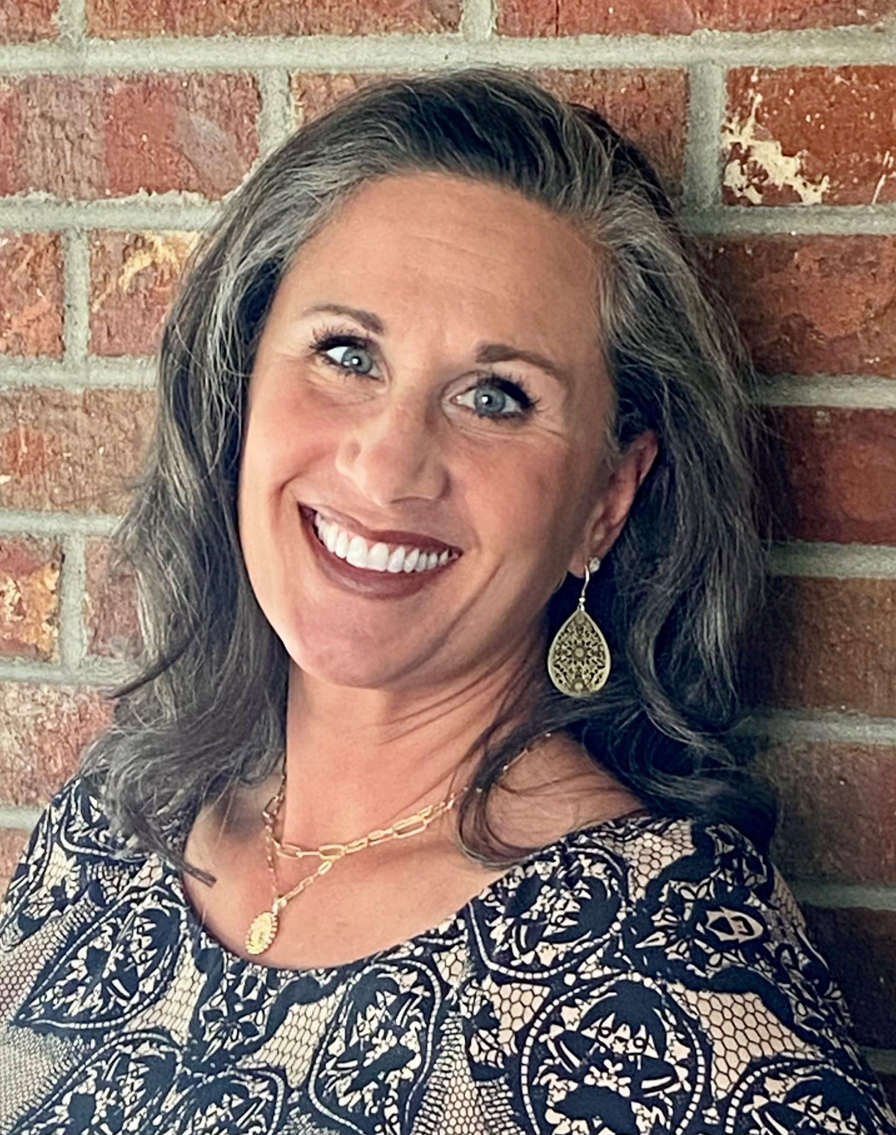
Presenters
Jennifer Bielat EVP, Client Strategy | Krista Byers National Director of Annual Giving @ JDRF International

Slide 3
Agenda
An Overview of Shifting Donor Expectations & Consumer Behaviors
Adapting to Donor Expectations - JDRF’s Journey
Q&A

Slide 4
Raise your hand if…
Notes:
How long have you been a fundraiser? 1-5, 5-10, 10+, 20+?
How do you spend the bulk of your time?
Annual, mid-major, gift officer
Raise your hand if it’s your first time in NOLA?
Raise your hand if you have drank a Hurricane since you got into town?

Slide 5
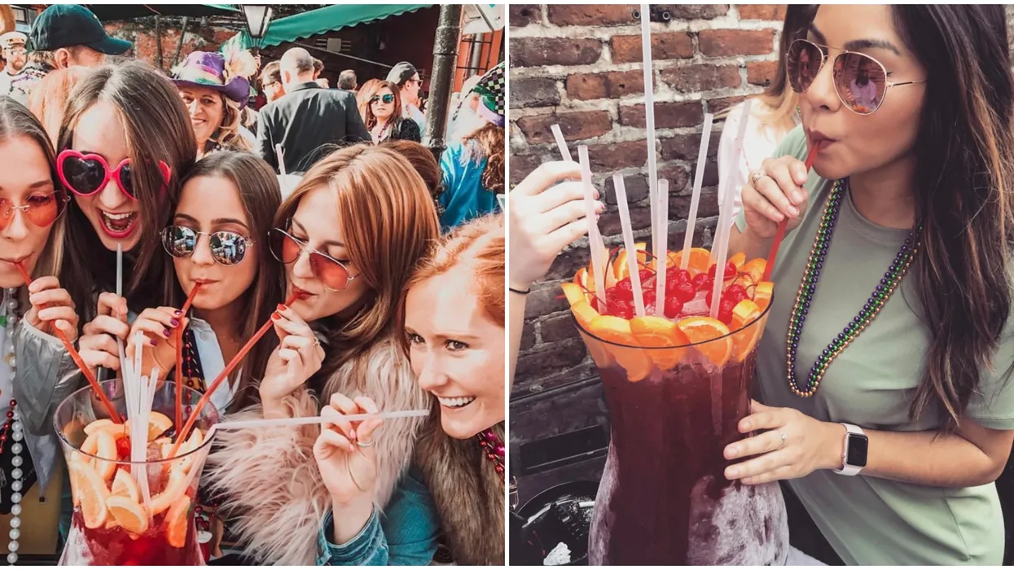
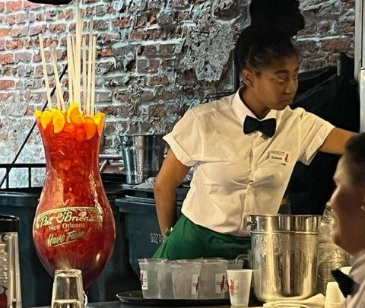
Notes:
$200 New Orleans Hurricane drink

Slide 6
Donor Expectations & Consumer Behaviors Are Changing…
Notes:
We should use this section to reflect on current events and the shifting behaviors of consumers in the face of the uncertain economy...slide into some points about leveraging data...like GNDA
Review Economic/fundraising landscape–pre and post pandemic
Constituent vortex slide
Consumer behavior trends - snapshot of major shifts
Constituent vortex slide - credit Claire Axelrad
Current events - shifting consumer behaviors related to the economy

Slide 7
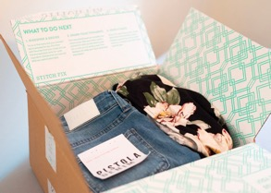
The shift to digital has accelerated
Nonsubcription
Notes:
We know that the migration from offline to online is well underway and transformative. I want to know how many of you subscribe to Stitch Fix?

Slide 8
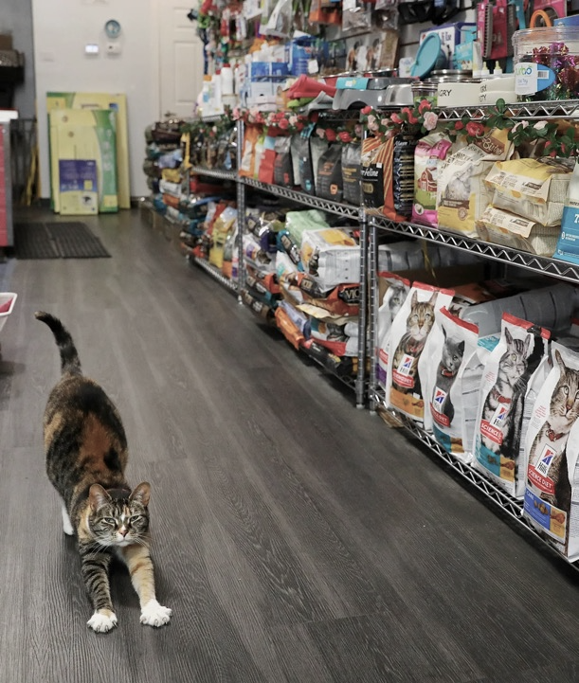
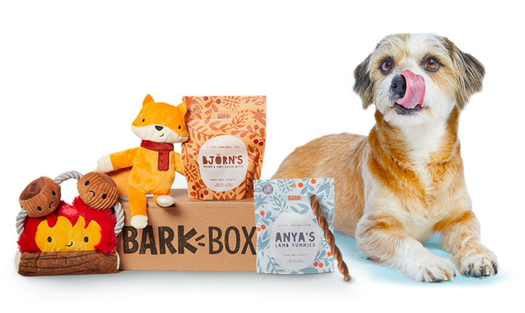
Consumers are comfortable with subscription payments
Notes:
Or have subscribed to a service. Like Blue Apron, Dollar Shave Club, or Birchbox
Subscription services have grown by more than 100 percent a year over the past five years.
Consumers find value in these services because they save time and money – some of them are clubs offering discounts or exclusive benefits - or they provide curate the shopping experience. The embrace of subscription services this threatens both brick and mortar as well as transactional e-commerce companies as these consumers behaviors change.

Slide 9
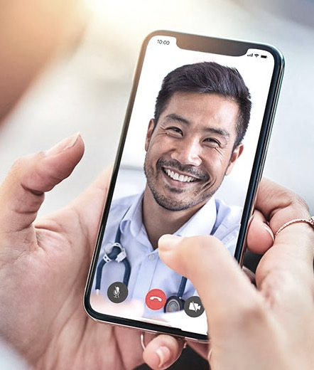
At-home consumption is growing further
Notes:
Matthew
Streaming vs theaters
Telemedicine vs the doctors office
Peleton vs the gym
Consumer behaviors have changed.

Slide 10
Trust with brands has never been more important
Notes:
Matthew
Consumers are demanding to know more about the products that they consume – from food labeling – to supply chain to political donations.
Consumer behaviors have changed

Slide 11
LOOKING FORWARD | 2023
INFLATION Prices are 6.4% higher; coming down but still high
INTERNATIONAL AFFAIRS
Ukraine War + Earthquake in Türkiye and Syria
WAGES ROSE Up 5% from Dec 2021 to Dec 2022
CONSUMER SENTIMENT 13-month high
in Jan 2023
INTEREST RATE HIKES
Not as large as 2022 but continuing to increase
STOCK MARKET
Volatile stock market with forecasts showing moderate improvement
FULL EMPLOYMENT
3.4% unemployment rate hit 53-year low in Jan 2023
BANKING CRISIS
Largest bank collapses since 2008, including a known lender for cryptocurrency, and start-up funder
Notes:
Full of contradictions
Wages rose but not enough to match inflation
Consumer sentiment is high but stock market is still volatile
Full employment but ongoing layoffs in the tech industry
International affairs impact unknown - interesting news cycles

Slide 12
Becoming your donor’s charity of choice makes you essential

Slide 13
When you are essential…
Your mail is opened
You are welcomed back again and again

Slide 14
When you are essential…
First time donors make the leap to a second-year gift

Slide 15
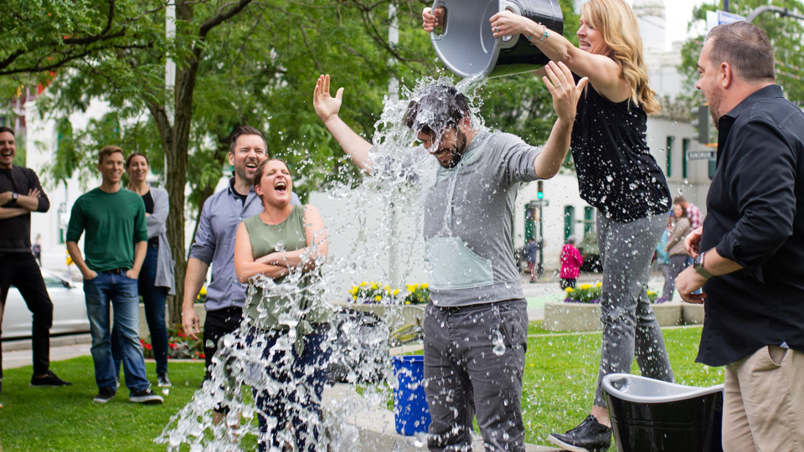
When you are essential…
A supporter chooses to give you their time

Slide 16
When you are essential…
You don’t get overlooked when times are tough

Slide 17
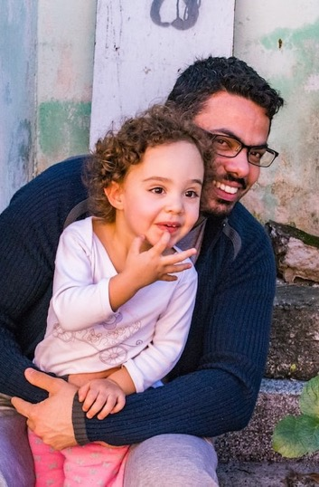
Becoming “essential”…
Builds resiliency within your donor file
Opens the door to relationship development
Drives growth at your organization
Notes:
MATTHEW

Slide 18
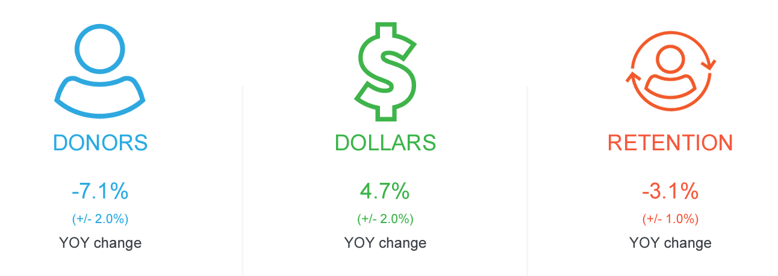
OVERALL GIVING TRENDS | Q1-Q3 ‘21 vs ‘22
2022 results through the third quarter show a steady decrease in overall donors, retention, and small size gifts.
Revenue is up slightly over 2021 driven in large part by strong Major & “Mega” donors.
*Data from the Fundraising Effectiveness Project – not adjusted for inflation
Notes:
Surprisingly, the greatest losses were New Retained Donors indicating “pandemic” donors are returning to pre-pandemic giving behaviors.
However, as New Donors represent 37% of all donors, their 19% decrease may be felt most strongly.
Stability in large donors kept fundraising revenue results fairly consistent in the face of unstable donor participation.

Slide 19
GENERATIONAL GIVING | 2016 vs 2022
Over the last five years, giving by Millennials increased by 40% while giving by other generations decreased.
Millennial
Gen Z
Increased 40% from $942 to $1,323
Gen X
Gave $747
(Only polled in 2022)
Baby Boomer
Decreased 4% from $1,265 to $1,220
*Data from Giving USA
Decreased 12% from $2,921 to $2,568
Notes:
Gen Z was only polled in 2022 so while we don’t see 5 year trends, this ‘baseline’ starting point metric will be important to monitor future growth or retraction.
Not too surprisingly, Millennials showed strong growth as, over the past five years, as they have matured in identifying causes and organizations close to their heart and have expanded their philanthropic capacity to make larger gifts. What is a bit surprising is the rate at which we’re seeing Millennial giving increase. Because we are also seeing an uptick in Millennials attending a house of worship, this could correlate to the increase in giving.

Slide 20
GENERATIONAL GIVING | 2016 vs 2022
Over the last five years, Millennials report an increased likelihood to give a gift influenced by direct mail.
Millennial
59%, compared to 53% in 2016
Gen Z
Gen X
Baby Boomer
45% influenced to give
(Only polled in 2022)
6% increase in likelihood to give based on a direct mail touch
52%, compared to 60% in 2016
52% compared to 53% in 2016
*Data from Giving USA
Notes:
Over the last five years, all generations have increased the average number of online gifts given in a calendar year.
Over the last five years, all generations except Boomers responded they would welcome a direct mail letter monthly.

Slide 21
Consumer beliefs and behaviors are changing.
Notes:
Matthew

Slide 22
Recap: The Changing Landscape
The shift to digital has accelerated
Consumers are comfortable with subscription payments
At-home consumption will grow
Trust with brands has never been more important
Generational giving is shifting
How Should Nonprofits Respond?
Notes:
Matthew

Slide 23
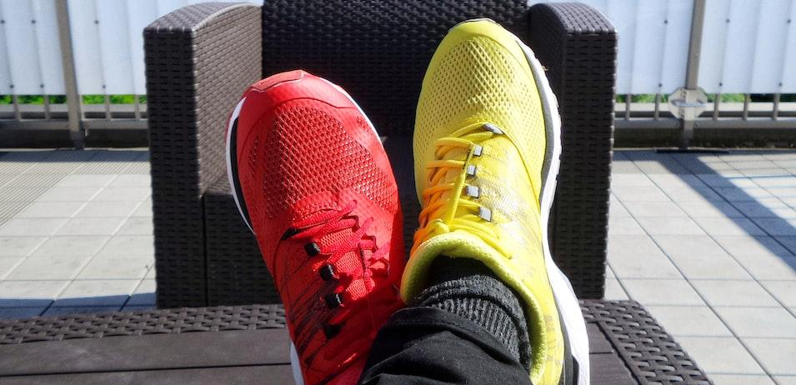
Different donors have different needs.
Notes:
We know that donor expectations have been ratched up for nonprofits thanks to the experiences of commercial brands.

Slide 24
$
Notes:
Everyone is familiar with the traditional donor pyramid. It’s a decent framework for thinking about moves management. We expect donors to upgrade as their relationship advances with us. But it’s a simplistic and perhaps antiquated perspective of donor engagement.

Slide 25
Event Captain
Survey responder
Advocate
Major
Today’s Reality
Sustainer
Volunteer
Subscriber
New Donor
Visitor
Addressable Universe
Influencer
Legacy
Service Recipient
Credit: Claire Axelrad
Notes:
The linear mindset of the past has been replaced by the shifting shape where we have constituents experiencing our brand through varied touchpoints. This shape brings complexity in the work we do every day as we focus on the constituent at the center.
Vortex is the new model for donor engagement and cultivation.
Donors enter at various points of the circle – instead of moving up or down –
Points of energy instead of stages – energy builds at the center where long-term donors reside
Acknowledges complexities of modern donor experience – focusing on donors not dollars

Slide 26
Our goal is to spark energy through interactions and engagement.
Create opportunities to engage
Create a seamless brand experience
Create community platforms enabling constituents to engage with one-another
Notes:
Fundraisers must create….
Not a small feat.

Slide 27
Fundraising programs have expanded far beyond annual fund and email campaigns
Notes:
Our fundraising just like our marketing is now omnichannel.
When we are building our strategies for fundraising and engagement, we have to think about how our donors are experiencing our brand throughout the day…they might get a piece of mail; or see a DRTV spot; be thumbing through FB posts.

Slide 28
What does an exceptional brand experience look and feel like?
Brand experience is sensations, feelings, cognitions, and behavioral responses evoked by brand-related stimuli that are part of a brand's design and identity, packaging, communications, and environments.
Notes:
It is important to think of about our brand holistic. Gone are the days of siloed departments. Marketing and Fundraising must work together to deliver an exceptional brand experience regardless of entry point into the organization.
What does it look and feel like? Is there anyone who wants to share briefly about a positive brand experience they have had? - Examples: Spotify Wrapped - personal experience, share their stats

Slide 29
I’m Recognized
Crisis
I’m Heard
I’m Valued
Notes:
When we think about an exceptional brand experience those brands are connecting at these base level needs - when I was new, when I was anxious - deepened my relationship and will drive value for the organization
And this isn't going to change
Any time these needs are met I'm going to be closer to an organization

Slide 30
Exceptional Experiences Deepen Relationships & Drive Value.
CREATE SATISFIED CUSTOMERS
INCREASE LOYALTY
LOWER COST TO SERVE

Slide 31
68% of US households
Delivers exceptional experiences to most loyal customers.
Spend 2x more than non-Prime members
Shop 2x more often throughout year
Less likely to price shop over time

Slide 32
Member benefits continue to evolve to delight – while driving loyalty and value.
Amazon Music Prime
Fast & Free Shipping
Amazon Originals Video
Whole Foods Member Deals
?
Prime Reading
Notes:
In order to continue to delight their customers, Amazon has evolved its offerings.

Slide 33
Creating Memorable Experiences Nonprofit Tactics
Facility Tours
Event Talks with Experts
Volunteer Engagement
Event Experiences with Fellow Supporters
Notes:
Surprise and delight moments…like a phone call or a nice handwritten note.
Does anyone have other ideas for creating memorable experiences?

Slide 34
Strengthened relationships drive value

Slide 35
Strengthening Relationships.
Make giving easy and joyful
Create a great first impression
Ask and honor preferences
Communicate impact
Nurture the highly involved
Notes:
Think about your gift processing, how long does it take to thank your donors? Are your landing pages intuitive or is there friction?
We have less than 3-5 seconds to make a first impression. Donors often take a thin slice so we want to show up well at the onset.
Listen to your donors. Create feedback loops like surveys so you can gather more information to personalize your touchpoints and honor preferences…always
Don’t forget to share with your donors the impact of their giving…whether that is through a newsletter, impact report, or a townhall call or webinar, making sure donors know how their gift was used is critically important.

Slide 36
Donor journeys give us the ability to build constituent experience that deliver lifetime value.
Notes:
Jo

Slide 37
Donor Journey.
Advocacy
Donor becomes an evangelist and encourages others to support.
Engagement
Donor continues evaluation of the organization and considers greater involvement
Commitment
Prospect becomes a donor with a first gift to the organization
Consideration
Prospect has growing interest and begins to learn more about work and impact
Awareness
Prospect becomes aware of the organization and mission
Notes:
https://siglcreative.com/2021/03/08/dear-church-you-need-a-customer-journey-too/

Slide 38
YOUR DATA TELLS THE STORY OF YOUR DONORS
Assess your donor file
Identify key opportunities
Develop experiences
Build a roadmap for growth
Notes:
Lean into your data to help craft the donor journey that will create that experience that strengthens the relationship

Slide 39
Experience creates moments of truth – either the ability to Awaken or Extinguish a relationship.

Slide 40
JDRF’s Journey

Slide 41
Background
Founded in 1970, JDRF is the leading global nonprofit funding type 1 diabetes (T1D) research.
8.7 million people living with type one diabetes across the world
1 in every 30 families are impacted by T1D

Slide 42
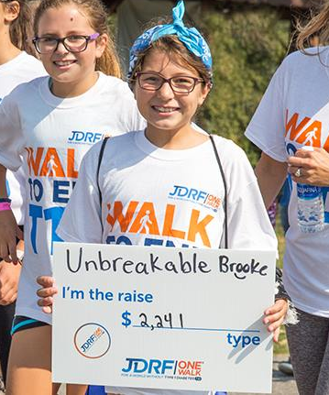
Background
JDRF has a mature event based fundraising model through our network of 29 chapters across the USA.
More than 50% of JDRF revenue is generated through One Walk® and Gala events.

Slide 43
Challenge:
Increase revenue through custom donor journeys for a chapter-based organization that is trying to advance fundraising programs
…during a pandemic

Slide 44
Opportunities:
Monthly Sustainer Program
Mid-Level Donor Program
Stewardship

Slide 45
GENERATIONAL GIVING | 2016 vs 2022
Over the last five years, the average number of online gifts made in a given 12 month period has increased in every generation.
 | Gen Z | Millennial | Gen X | Boomer
2016 | N/A | 4.1 | 3.6 | 4.0
2022 | 11.4 | 7.7 | 6.3 | 8.3
*Data from Giving USA
Notes:
Drop in link to GivingUSA Generational Giving: https://drive.google.com/file/d/1h4xmQ5bAziSRap778nTfyriWfOoZRaKj/view?usp=sharing

Slide 46
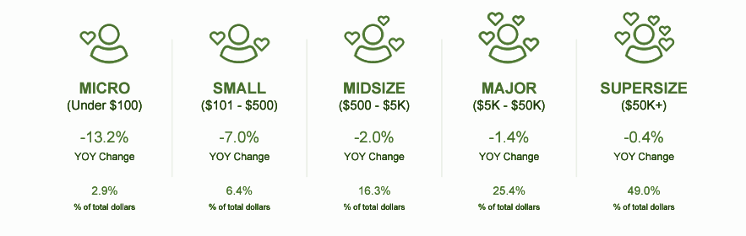
Opportunity to Retain more “Small” Donors
*Data from AFP Fundraising Effectiveness Project Q3 2022

Slide 47
2020 Monthly Sustainer Program
100% organic
Majority connected to T1D
Giving to JDRF for 5+ years
Inspired by
Research and clinical trials to drive T1D treatments and cures
Technology to improve T1D management
Advocacy to improve access to care
Desire to step up and prioritize their giving to a cause they are passionate about.

Slide 48
2023 Monthly Sustainer Program
Targeted digital and mail campaigns
Created a brand
Increased website visibility
All campaign and website donation pages offer variable gift array for monthly giving

Slide 49
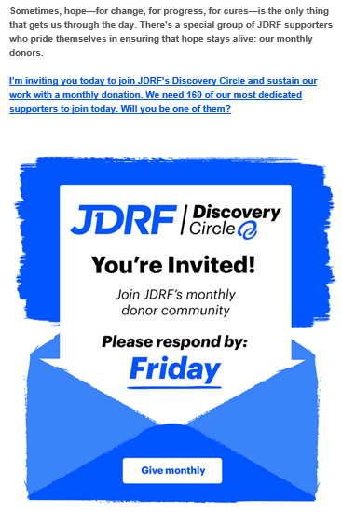
2023 Monthly Sustainer Program

Slide 50
Results
↑81%
↑67%
$1M+
Sustainer File Growth | File Revenue Growth | FY 23 Revenue Projections
Notes:
JB - add notes on how, despite the tough economy, the sustainer program offers some resilicincy. And my CFO loves it!

Slide 51
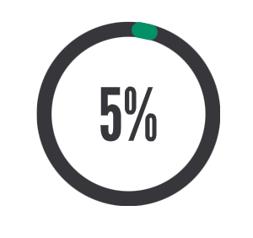
2023 Mid-Level Donor Pilot
Objective
Challenge
5% of JDRF’s donor base generates 25% of revenue.
12,000+ mid-level donors and less than 29 staff to cultivate them.
Build a reliable, sustainable revenue stream and a robust pipeline to our mid, major and legacy giving programs.
Leverage data and technology to create transparency, partnership, and relationship management for our donors

Slide 52
2023 Mid-Level Donor Pilot
Opportunity
Increase retention, revenue and lifetime value over time
All chapters have donors in the pilot
Measure impact across JDRF – not just within direct appeal
Short-term revenue gains, but true value is longer-term

Slide 53
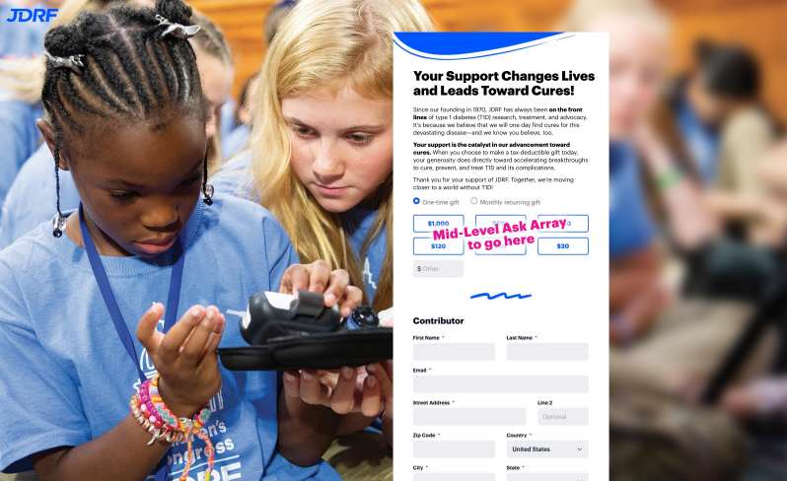
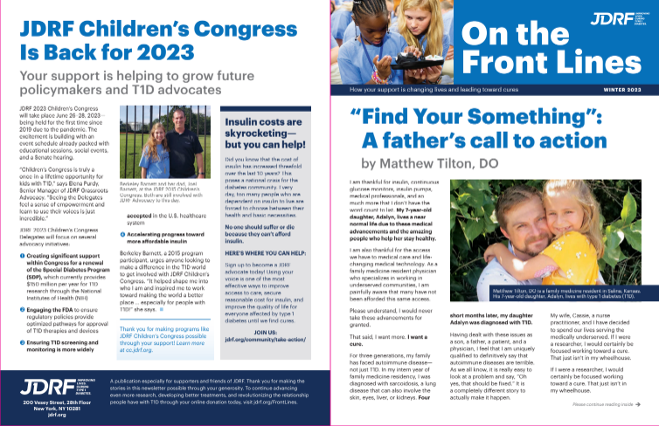
Mid-Level Program
Landing Page + Newsletter
Notes:
Share any results that may be available - it’s not a short term strategy. You’ll see dividends over a long period of time. JB can chime in

Slide 54
2023 Stewardship Program
Goal: Protect our acquisition investments through:
New donor welcome (mail and digital) | Voice broadcast | Note cards | Impact newsletters for sustainer and mid-level donors | Stewardship video
Notes:
She needs to do a set up around acquisition first. They’ve been on a journey with their acquisition investments.

Slide 55
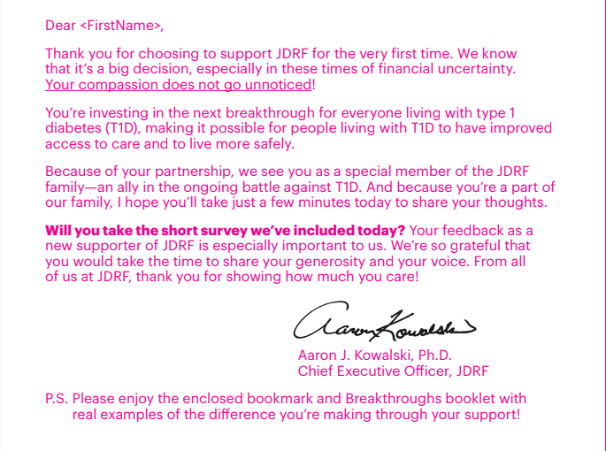
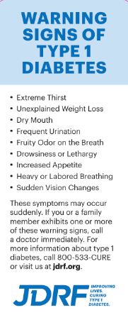
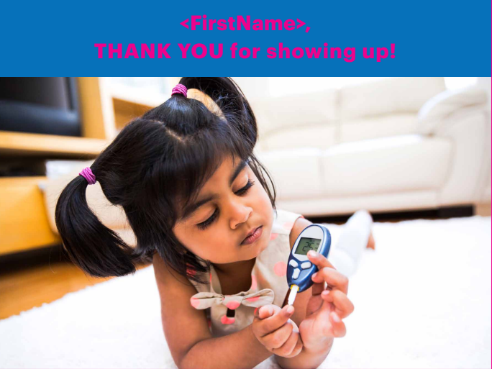
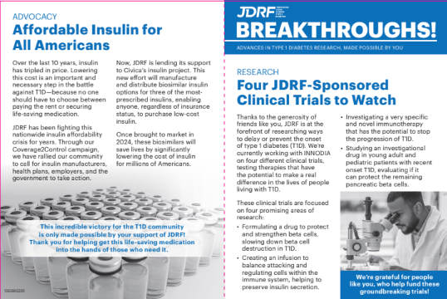
Creating a Great First Impression
New Donor Welcome Series

Slide 56
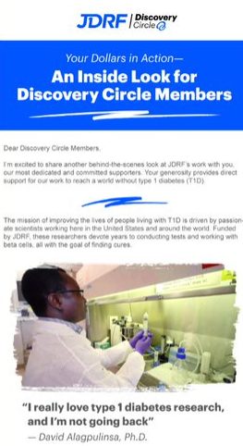
Powerful Stewardship

Slide 57
Recap: JDRF’s Goals
Increase retention through building a stronger connection with donors
Demonstrate how a larger, transformative gift can impact the mission to drive more revenue
Create a meaningful experience for sustainers and build a consistent revenue stream
Cultivate a pool of loyal future mid-level, major, and planned giving donors

Slide 58
Reflection: What Are YOUR Goals?
Notes:
If Krista is the last speaker here before Q&A, she needs to reflect on her journey with JDRF and how things are evolving.

Slide 59
Q&A

